Slide 1
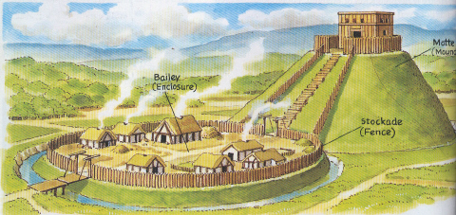
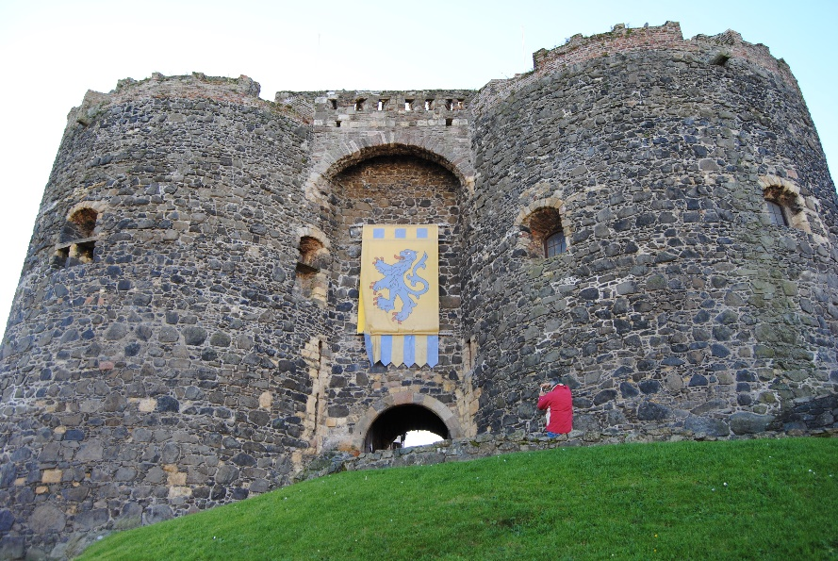
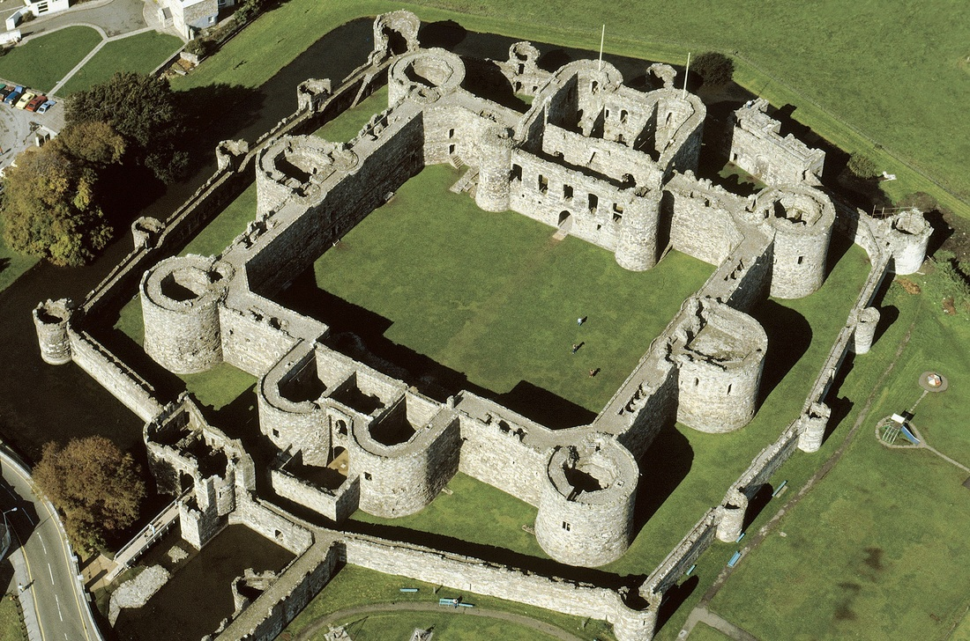
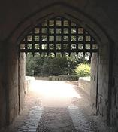
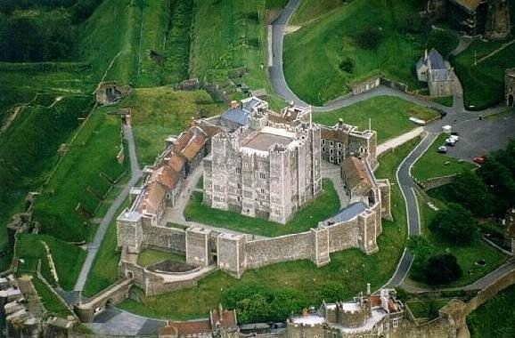
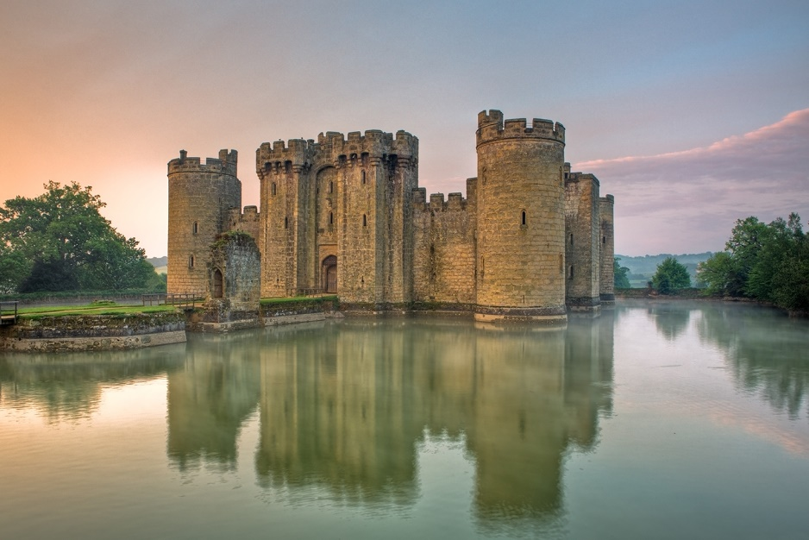
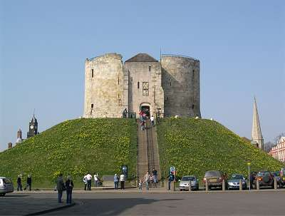
Castles in the Middle Ages

Slide 2
Learning Outcomes
You will be able to:
Explain why castles were built
Describe the advantages and disadvantages of three different types of castles

Slide 3
https://www.youtube.com/watch?v=RXXDThkJ3Ew
https://www.youtube.com/watch?v=DGXx56WqqJw

Slide 4
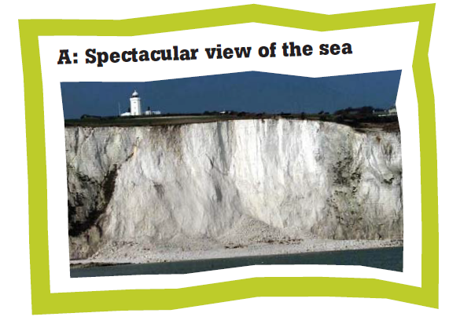
Where’s the best place to build a castle?

Slide 5
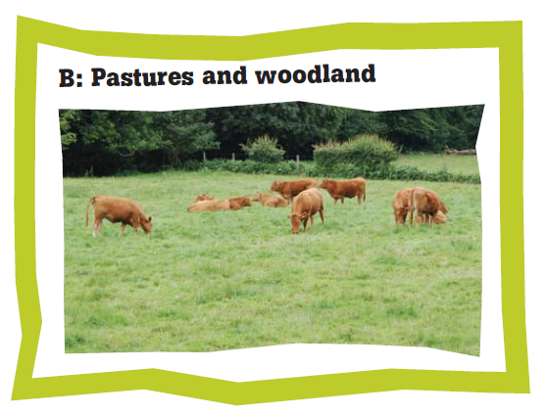
Where’s the best place to build a castle?

Slide 6
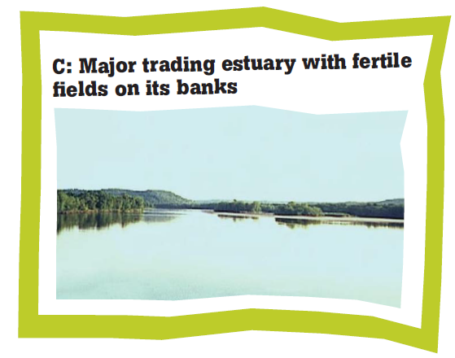
Where’s the best place to build a castle?

Slide 7
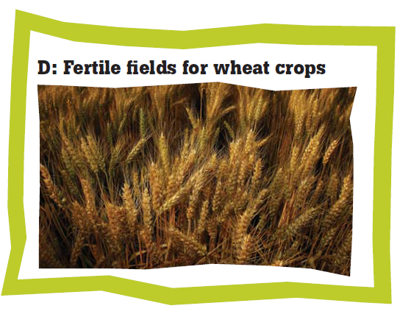
Where’s the best place to build a castle?

Slide 8
Where’s the best place to build a castle?

Slide 9
Where’s the best place to build a castle?

Slide 10
Why castles?
When William invaded England he quickly set about building castles.
The reason:
He had nowhere near enough men to run England.
Especially as the English did not have many castles before the Normans came along!
So William built castles at important places – hills, rivers, towns – so that if the English tried to control the country they’d be forced to attack a castle – a bad move!

Slide 11
The Motte and Bailey Castle
The Normans built the first proper castles in England. They needed bases from which to control the countryside, and strongholds to protect them from Saxon attack.
The castles had to be built in a hurry, so they were originally built of timber on an earth mound (a motte). The bailey was the living area for the soldiers.

Slide 12
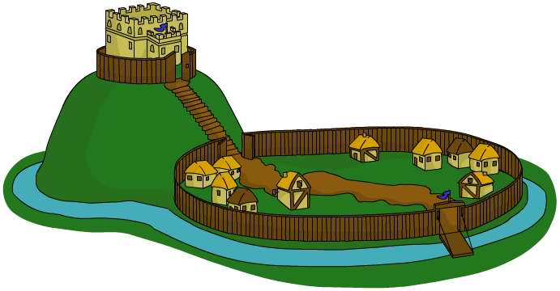
Motte – defensive mound of earth
Keep – the safest place in the castle
Bridge – from the motte to the bailey
Drawbridge – to the entrance to the bailey
Moat – this made it harder to reach the walls
Palisade – these were made of wood and formed a fence
Bailey – large walled area where the soldiers and animals lived
The Motte-and-Bailey Castle

Slide 13
The Motte and Bailey Castle
Advantages
Quick, cheap, and easy to build
Showed strength and control
Can see potential attackers from top of tower
Thick walls
Drawbridge closes for additional protection
Disadvantages
Made of wood: can burn or rot easily
Wooden castles not very strong…
Palisade easily broken by battering ram

Slide 14
Traditional Square Keep Castles
Advantages:
Tall thick stone walls made it difficult to climb over or break through.
Narrow windows for shooting arrows out of.
The entrance had a large outer gate that could be pulled up.
There was an inner gate made out of metal called a portcullis.
Large, and lots of room for soldiers, who lived in the top stories.
Spiral staircase made difficult to storm upper floors

Slide 16
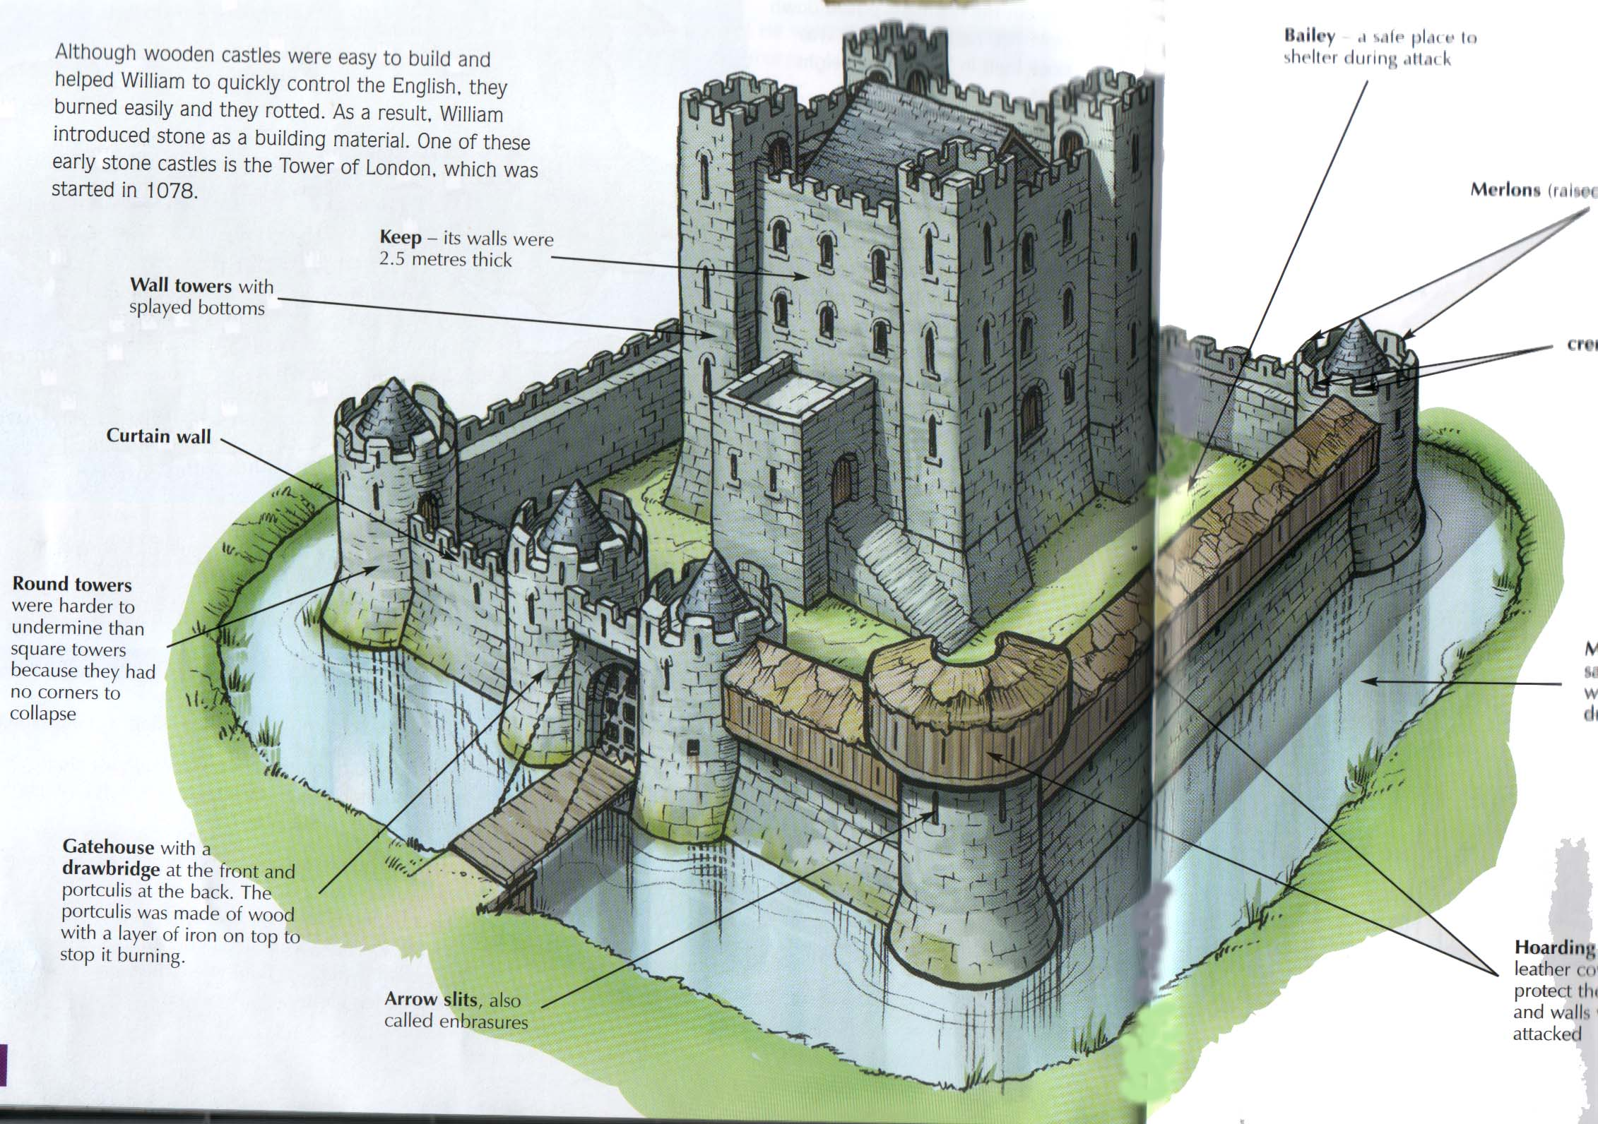

Slide 17
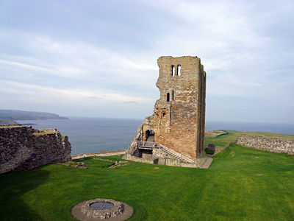
Traditional Square Keep Castles
Disadvantages
-Attackers can get right up close to the walls.
-Once up close, attackers were very hard to shoot.
-The corners were difficult to protect.
-Knocking out one corner could take down two walls.

Slide 18
Concentric Castles
Advantages:
The corners had a round turret for protection.
They built a second, lower wall.
Archers could fire over low wall.
If outer wall failed, they were trapped “death hole”.

Slide 19
Disadvantages
Concentric Castles
Need for a large garrison to defend it. Difficult to defend with limited soldiers
Walls could not stand up to cannon fire

Slide 20
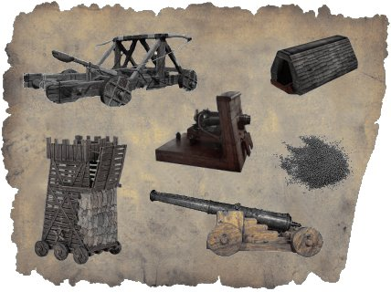
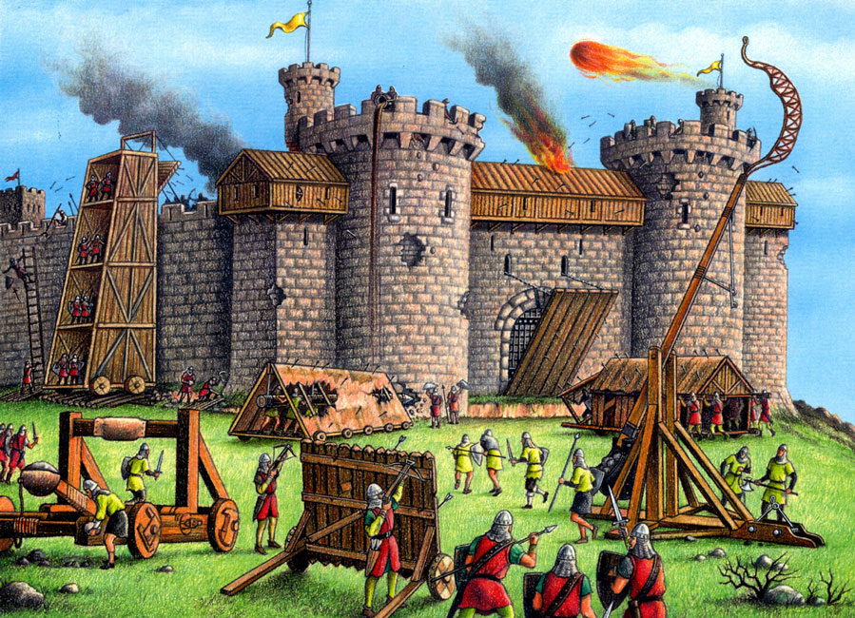
Castles & War

Slide 21
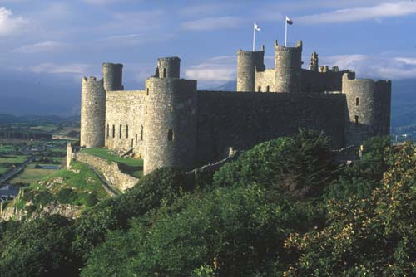
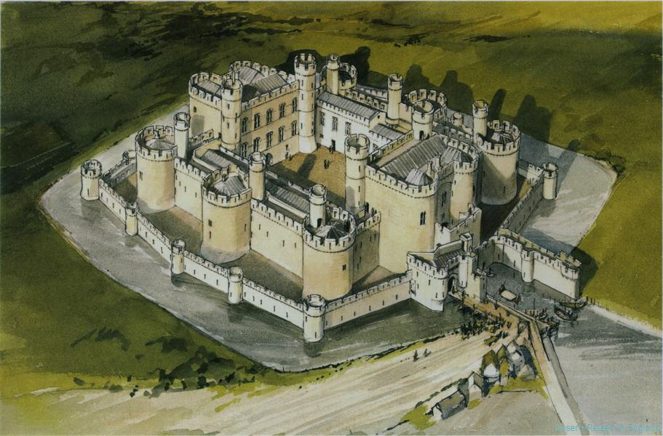
Review: Which kind of Castle is it?

Slide 22
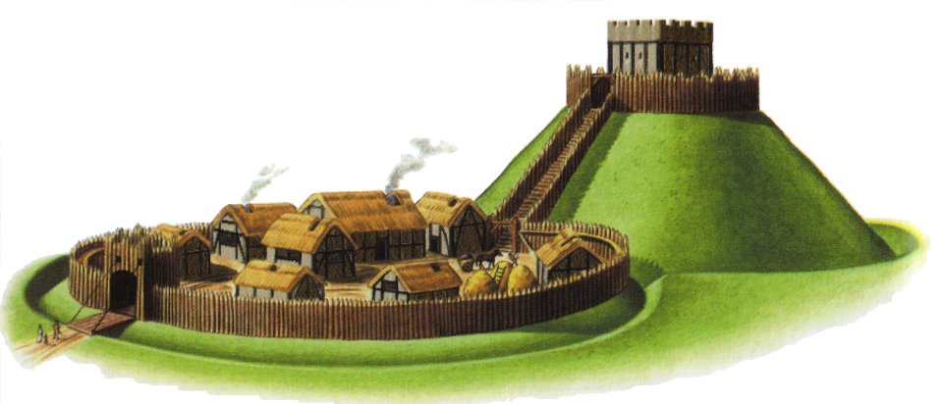
Review: Which kind of Castle is it?

Slide 23
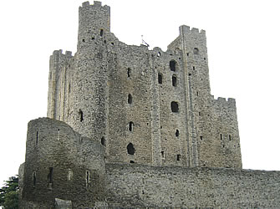
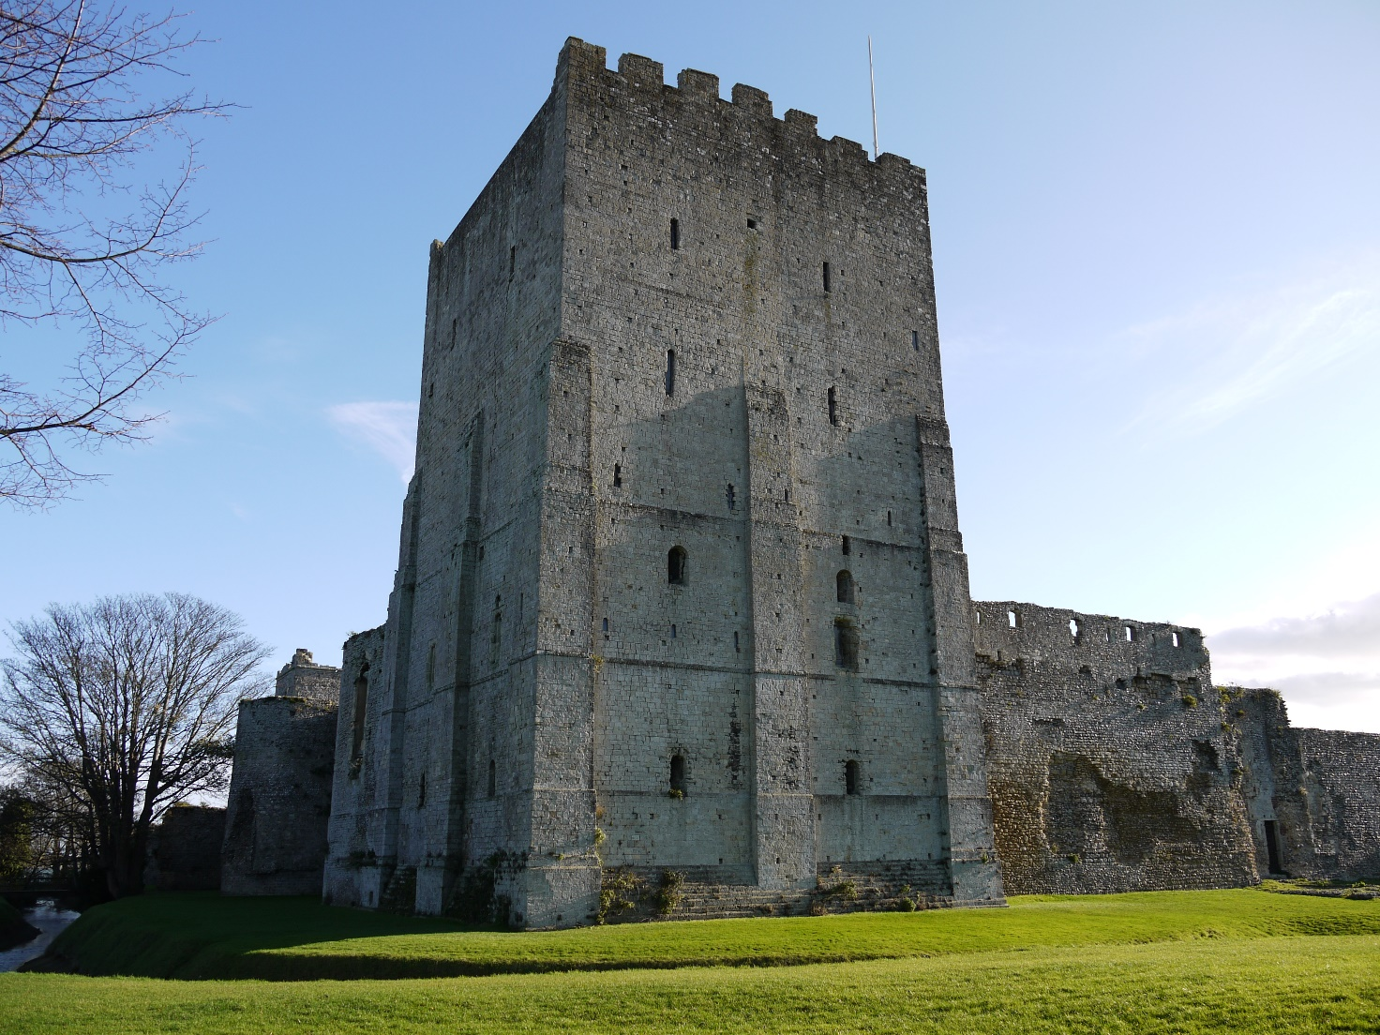
Review: Which kind of Castle is it?

Slide 24
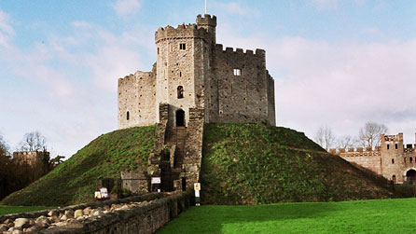
Review: Which kind of Castle is it?

Slide 25
Castles & War
War in medieval times was about the control of land.
Garrisons of knights and other soldiers who lived in castles controlled the land around their stone fortresses.
To conquer a territory, an attacking army would have to strike and take these central strongholds.
To do so, they would launch a siege.

Slide 27
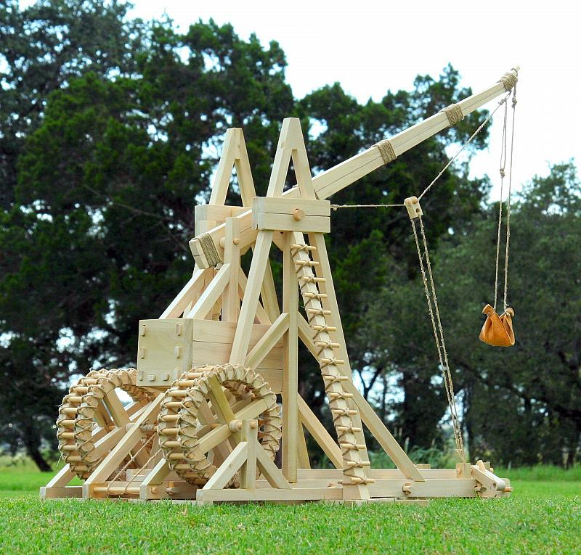
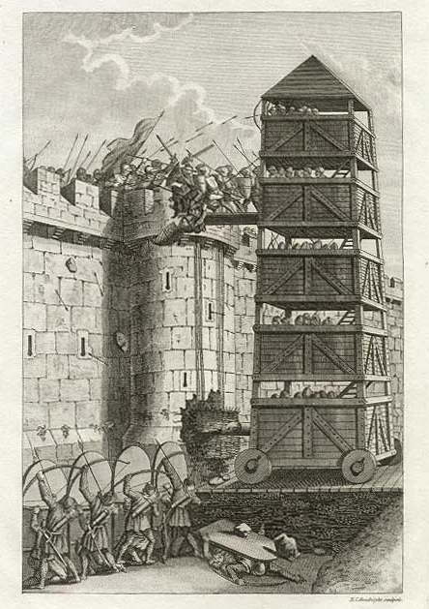
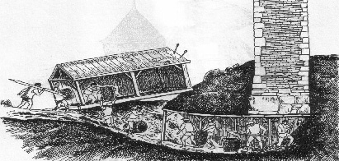
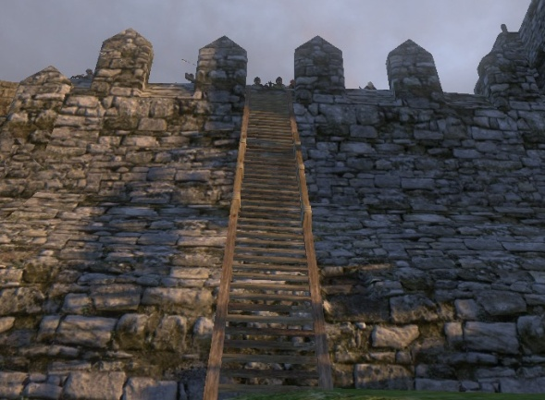
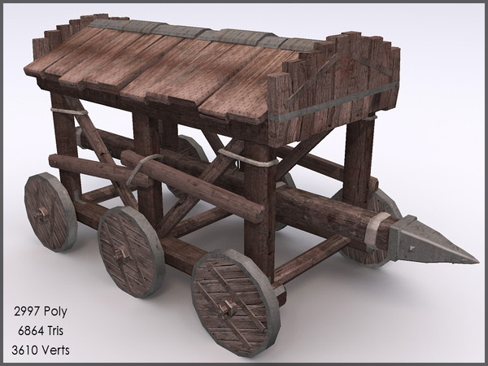
Over, Under, Through!
Trebuchet
Tunnels under the wall
Siege ladders and towers
Battering ram

Slide 28
Siege Weapons
Siege Weapons
Trebuchet https://www.youtube.com/watch?v=pR26RMI9T8c
Siege Tower https://www.youtube.com/watch?v=qXsYJD3BJlQ
Crossbow https://www.youtube.com/watch?v=Ziq5zm4uO-Y
Longbow https://www.youtube.com/watch?v=bGcm-J1ggfw
Battering Ram https://www.youtube.com/watch?v=kz60knnHNaU

Slide 29
How would you attack a Castle?
Your Task: Create an attack plan for a castle (In pairs or individually)
Decide which type of castle you are going to attack
Based on the type of castle and its weaknesses, decide which weapons you will need and how big of an army you need
Create your attack plan (must include some drawing and some text/labels describing the plan)
Criteria:
Shows or describes the type of castle you are attacking, as well as the surrounding area
Uses realistic, historically accurate weapons
Includes some images (drawings) as well as some writing or labels
Plan is logical and shows understanding of Medieval castles and weapons

